Slide 1

Fire detection system
St. Francis Institute of Technology
Information Technology
IoT Mini Project (ITL504)
Mentor: Dr. Prachi Raut
Abhishek Sunkale Roll No.44
Prithvi Shetty Roll No.41
Smily Tuscano Roll No.48

Slide 2
Overview
Introduction
Literature survey
Problem statement
System design
Circuit diagram
System requirements
Conclusion
References

Slide 3
Introduction
The Internet of Things (IoT) is a system of interrelated computing devices, mechanical and digital machines, objects, animals or people that are provided with unique identifiers and the ability to transfer data over a network without requiring human-to-human or human-to-computer interaction.The Internet of Things is actually a pretty simple concept, it means taking all the things in the world and connecting them to the internet.
In a metropolitan city like Mumbai with the presence of large of number of people homes poses a huge fire threat due to negligence and also with so many inflammable items –upholstery , decorative material , gas leaks,and electrical gadgets among others
India has lost 60,607 lives during the period 2015-18 of which 56% were accounted for home/residential fire.(ADSI).Thus residential fire becoming the largest source of fatalities.

Slide 4
Introduction
Fire alarm and detection technology should help to detect fire at sufficiently early stage so that it can help to reduce the damage to human life and property

Slide 5
Literature Survey
Reference | Methodology | Advantages | Future scope
[1] | Arduino sensor, flame sensor and GSM used for fire detection and visual guidance system | Allows quick assessment of location of fire by determining the exact point of occurrence of fire | Nothing is mentioned
[2] | DHT 11 sensor which is connected to internet to monitor temperature and humidity rate | Design and implementation of fire detection is customizable and flexible | Can be improved by adding multiple sensors systematically
[3] | Uses LM35 sensor GSM and Arduino to create home fire alarm | The device will instantly alert user when the temperature limit is reached thanks to LM35 sensor | Sensor with higher range coverage can be developed for purpose of the system.

Slide 6
Literature Survey
Reference | Methodology | Advantages | Future scope
[4] | Uses 4 environment sensors , GSM module ,sg 90(servo motor) and Arduino pro mini to create SMS based fire alarm system | Reliable service which would alert nearest fire department , poses large scalability . | Real time information of smoke or heat level observed by every detector device in surveillance.
[5] | GSM based fire alarm system uses GSM module , Arduino , LCD and LM35 as main temperature sensor | Easy implementation , maximum reliability , user friendly and low cost which could be used for home and industrial security system | Fire proofing the system would be recommended in order to prevent damages to hardware components

Slide 7
Literature Survey
Reference | Methodology | Advantages | Future scope
[6] | Arduino Uno ,LM35 Temperature sensor , smoke detector and a low-cost Wifi chip: ESP8266 is used to create an sms based fire detection system | Notifies via SMS system, reliable, efficient, can used for home security fire detection systems | Interconnection between multiple system can be created and Android application for the system can be developed to control it either automatic or manually.

Slide 8
Research Gaps Identified
Research Gaps:
-False alarm prevention should be installed.
-Applications and monitoring systems should be developed for
android and other platforms for monitoring and controlling such systems
-System can be optimized to make it more user friendly

Slide 9
Problem Statement
To develop an IOT based fire detection system which can be used for houses and residential places to detect fire and alert the residents . Our system will use LM 35 temperature sensor and a GSM module in combination for reliability and data will be connected to IOT via SMS.

Slide 10
Problem solution
To develop a reliable fire detection system having lm 35 sensor and gsm module in which sensor detects the temperature change and tries to alert the person as soon as possible via gsm module.
We will use Arduino uno based iot platform to develop this system.

Slide 11
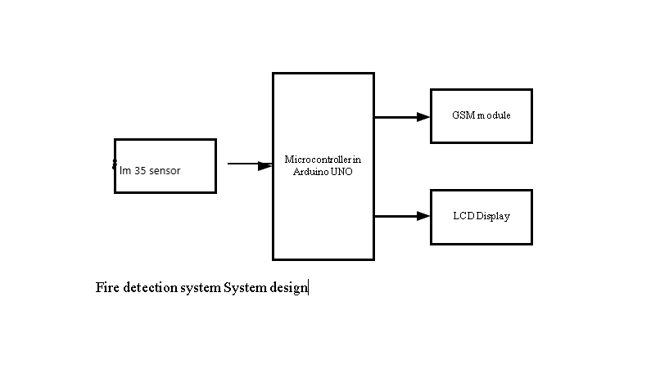
System Design

Slide 12
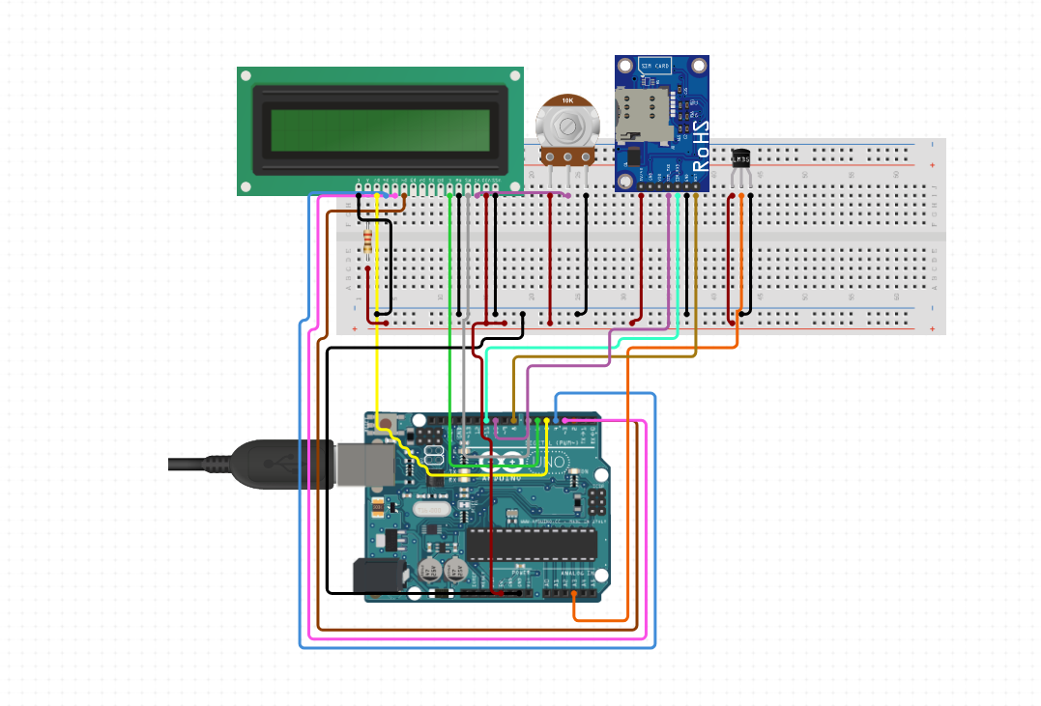
Circuit Diagram

Slide 13
System Requirements
Hardware Components
sr.no |  | Component |  |  |  | Numbers |  | costs
1 |  | Arduino Uno board |  |  |  | 1 |  | 1*437=437
2 |  | LM 35 sensor |  |  |  | 1 |  | 123*1=123
3 |  | LCD 16*2 |  |  |  | 1 |  | 1*255=255
4 |  | GSM module |  |  |  | 1 |  | 1*558=558
5 |  | Breadboard |  |  |  | 1 |  | 1*200=200
6 |  | Jumper wires |  |  |  | 1 packet |  | 1*200=200
7 |  | 10 k potentiometer |  |  |  | 1 |  | 130
 |  |  |  |  |  |  |  | Total = Rs 1903
Software Requirements
sr.no |  | Component |  |  |  | costs
1 |  | windows 10 |  |  |  | Rs 6000(not adding)
2 |  | Circuito.io |  |  |  | open source
3 |  | Arduino ide |  |  |  | open source
 |  |  |  |  |  |  |  | Total = Rs 1903

Slide 14
Conclusion
We have developed a fire alarm system using the arduino and Lm 35 sensor. The developed prototype used reliable instruments that were suitable to develop a fire detector and it is an eco-friendly design
The total cost of this project was Rs.1903.The project was completed under the guidance of Dr . Prachi Raut.

Slide 15
Future scope
Interconnection between multiple system.
Android application for the system to control it either automatic or manually.
Different sensors can be used such as gas sensor or smoke sensors.

Slide 16
References
Cite the references in IEEE format
[1]kumar, n. and kumari, p., 2018. Intelligent Fire Detection And Visual Guided Evacuation System Using Arduino And GSM. [online] Ijrter.com. Available at: <https://www.ijrter.com/papers/volume-4/issue-12/intelligent-fire-detection-and-visual-guided-evacuation-system-using-arduino-and-gsm.pdf> [Accessed 8 September 2020].
[2]Abdul Khaleq, Noor & Khalaf, Osamah & Addulsahib (2019). IOT fire detection system using sensor with Arduino. AUS. 74-78.available [online]:https://www.researchgate.net/publication/335790885_IOT_fire_detection_system_using_sensor_with_Arduino/link/5d7b7db84585155f1e3f2a3a/download [Accessed: 08- Sep- 2020].
[3]N. Mazhan, N. Enzai and N. Zin, "ShieldSquare Captcha", Iopscience.iop.org, 2020. [Online]. Available: https://iopscience.iop.org/article/10.1088/1742-6596/1019/1/012079/pdf. [Accessed: 08- Sep- 2020].

Slide 17
References
[4]Izang, A., Ajayi, S., Adeniye, F., &amp; Adepoju, A. (2018). An SMS Based Fire Alarm and Detection System. Retrieved September 08, 2020, from International Journal of Computer Trends and Technology (IJCTT) available at:https://www.ijcttjournal.org/2018/Volume58/number-1/IJCTT-V58P109.pdf
[5]Paul, D., Ghosh, A., &amp; Banerjee, S. J. (2016). GSM Based Fire Sensor Alarm Using Arduino. Retrieved September 08, 2020, from International Journal of Scientific &amp; Engineering Research available [online]:https://www.ijser.org/researchpaper/GSM-Based-Fire-Sensor-Alarm-Using-Arduino.pdf
[6]Shah, R., Satam, P., Sayyed3, M. A., &amp; Salvi, P. (2019). Wireless Smoke Detector and Fire Alarm System. Retrieved September 08, 2020, from International Research Journal of Engineering and Technology available at:https://www.irjet.net/archives/V6/i1/IRJET-V6I1258.pdf

